Slide 1
CSE477
VLSI Digital Circuits
Fall 2002
Lecture 25: Peripheral Memory Circuits
Mary Jane Irwin ( www.cse.psu.edu/~mji ) www.cse.psu.edu/~cg477
[Adapted from Rabaey’s Digital Integrated Circuits, ©2002, J. Rabaey et al.]

Slide 2
Review: Read-Write Memories (RAMs)
Static – SRAM
  data is stored as long as supply is applied
  large cells (6 fets/cell) – so fewer bits/chip
  fast – so used where speed is important (e.g., caches)
  differential outputs (output BL and !BL)
  use sense amps for performance
  compatible with CMOS technology
Dynamic – DRAM
  periodic refresh required
  small cells (1 to 3 fets/cell) – so more bits/chip
  slower – so used for main memories
  single ended output (output BL only)
  need sense amps for correct operation
  not typically compatible with CMOS technology

Slide 3
Review: 4x4 SRAM Memory
read precharge
2 bit words
bit line precharge
enable
WL[0]
BL
!BL
A₁
WL[1]
Row Decoder
A₂
WL[2]
WL[3]
A₀
Column Decoder
clocking and control
sense amplifiers
BL[i]
BL[i+1]
write circuitry
Notes:
To decrease the bit line delay for reads – use low swing bit lines, i.e., bit lines don’t swing rail-to-rail, but precharge to Vdd (as 1) and discharge to Vdd – 10%Vdd (as 0). (So for 2.5V Vdd, 0 is 2.25V.) Requires sense amplifiers to restore to full swing.
Write circuitry – receives full swing from sense amps – or writes full swing to the bit lines

Slide 4
Peripheral Memory Circuitry
Row and column decoders
Sense amplifiers
Read/write circuitry
Timing and control

Slide 5
Row Decoders
Collection of 2^{M} complex logic gates organized in a regular, dense fashion
(N)AND decoder
  WL(0) = !A₉!A₈!A₇!A₆!A₅!A₄!A₃!A₂!A₁!A₀
  …
  WL(511) = !A₉A₈A₇A₆A₅A₄A₃A₂A₁A₀
NOR decoder
  WL(0) = !(A₉+A₈+A₇+A₆+A₅+A₄+A₃+A₂+A₁+A₀)
  …
  WL(511) = !(A₉+!A₈+!A₇+!A₆+!A₅+!A₄+!A₃+!A₂+!A₁+!A₀)

Slide 6
Dynamic NOR Row Decoder
V_{dd}
WL₀
WL₁
WL₂
WL₃
A₀
!A₀
A₁
!A₁
precharge
Notes:
Dynamic 2-to-4 NOR decoder – precharge all outputs high, then GND inactive outputs - active “high” output signals
Note that signal goes through at most one fet (so constant propagation delay (in theory)) – some output wires have two parallel paths to GND
Also note, that the capacitance of the output wires goes linearly with the decoder size (linear grow in fet diffusion capacitance)

Slide 7
Dynamic NAND Row Decoder
WL₀
WL₁
WL₂
WL₃
!A₀
A₀
!A₁
A₁
precharge
Notes:
Dynamic 2-to-4 NAND decoder – precharge all outputs high, then discharge active output - active “low” output signals
Must ensure that all input signals are low during precharge – else Vdd and GND connected!
Note that the number of fets goes linearly with the decoder size – 2-to-4 has two fets in series, 3-to-8 has 3 fets in series, etc.- so will be slower than the NOR implementation if the gate capacitance dominates diffusion capacitance

Slide 8
Split Row Decoder
!(!(!A₀!A₁!A₂) + !(!A₃!A₄!A₅) +!A₆)
WL₀
WL₀
*128
*128
WL₁₂₇
WL₁₂₇
!(!A₀!A₁!A₂)
. . .
!(A₀A₁A₂)
*8
*8
*7
Address<6:0>
*7
Notes:
Since address decoders need to interface with the core array cells, pitch matching with the core storage array can be difficult.
Can improve pitch and improve speed by splitting the decoder into smaller pieces.
Propagation delay reduced by a factor of 4 (# of inputs halved) – squared since dependency between delay and fan-in; and the load on the vertical address lines halved (also reducing the delay)
Also reduced the number of transistors – e.g., for a 10 input decoder with a 4-bit predecoder has 1024*6 (row decoder) + 5*4*4 (predecoder) = 6,224 as compared to 11*1024 = 11,264 yielding a 55% reduction
Address bit predecoded; the 18 lines of predecoded values are clocked and routed across the 128 array of final decoders. Each final decoder taps into one signal from each of the three sets to perform the final level of decoders.
Note that final row drivers have to drive a very long and heavily loaded word line, so have to drive them carefully (see lecture 24 – positioned in the center of the array, replicating circuitry at each end, strapping cells, etc.)

Slide 9
Pass Transistor Based Column Decoder
BL₃
!BL₃
BL₂
!BL₂
BL₁
!BL₁
BL₀
!BL₀
S₃
A₁
S₂
2 input NOR decoder
S₁
A₀
S₀
Data
!Data
Advantage: speed since there is only one extra transistor in the signal path
Disadvantage: large transistor count
Notes:
Essentially a 2**k input multiplexer
Can run the NOR decoder while the row decoder and core are working – so only have 1 extra transistor in the signal path
Transistor count – 2*(k+1)2**k + 2**k devices - so for k=10 (1024 to 1) it would require 2*12,288 transistors (11*1024 + 1024)

Slide 10
Tree Based Column Decoder
BL₃
!BL₃
BL₂
!BL₂
BL₁
!BL₁
BL₀
!BL₀
!A₀
A₀
!A₁
A₁
Data
!Data
Advantage: number of transistors drastically reduced
Disadvantage: delay increases quadratically with the number of sections (so prohibitive for large decoders)
  fix with buffers, progressive sizing, combination of tree and pass transistor approaches
Notes:
Note no predecoder needed as with previous design
Number of transistors comes down to 2* 2*(2**k – 1) – so for k=10 (1024 to1) requires only 2*2,046 transistors

Slide 11
Bit Line Precharging
Static Pull-up Precharge
Clocked Precharge
clock
BL
!BL
BL
!BL
equalization transistor - speeds up equalization of the two bit lines by allowing the capacitance and pull-up device of the nondischarged bit line to assist in precharging the discharged line
Notes:
Static pullup scheme – advantage is that it does not require a heavily loaded precharge clock signal to be routed across the array; disadvantage is that it is always on, so is fighting against the bit line discharge for the bit lines that are moving low (consumes power)
Clocked scheme – allows the designer to use much larger precharge devices so that bit line equalization happens more rapidly (note equalization transistor to help even more); disadvantage is the power consumption of the heavily loaded precharge clock signal.

Slide 12
Sense Amplifiers
small
t_{p} = ( C * ΔV ) / I_{av}
large
make Δ V as small as possible
Use sense amplifiers (SA) to amplify the small swing on the bit lines to the full rail-to-rail swing needed at the output
SA
input
output

Slide 13
Latch Based Sense Amplifier
bit lines
ΔV = 0.1V_{dd}
isolate
sense
sense amplifier outputs
ΔV = V_{dd}
Notes:
BL and !BL precharged to Vdd
Once adequate voltage gap created on BL and !BL, sense amp enabled with “sense” line
Positive feedback quickly forces output to a stable operating point

Slide 14
Alpha Differential Amplifier/Latch
S₃
column decoder
S₂
S₁
S₀
precharge
mux_out
!mux_out
0->1
sense
amplifier
P1
P2
N3
N5
sense
N2
N4
sense
N1
ΔV = V_{dd}
0->1
off->on
P3
P4
Pre -> Closed)
sense_out
!sense_out
Notes:
N2 and N4 sense the voltage change on the bit lines (gates are connected to the two bit lines coming from the column decoder)
N1 enables the SA by providing current to the two detection devices.
The cross-coupled inverter pair (P1/N3 and P2/N5) is used to amplify the detected voltage differential.
Finally, a set of inverters is used to buffer the output of the SA.
Operation begins with sense in low state. P3 and P4 precharge sense and !sense to Vdd and the bit lines gating N2 and N4 are precharged to Vdd. As the read begins one of the two input lines will begin to discharge and sense is asserted. This causes the pulldown N1 to turn on supplying current to the two legs of the SA.

Slide 15
Read/Write Circuitry
!BL
BL
D: data (write) bus
R: read bus
W: write signal
CS: column select
(column decoder)
Local W (write):
BL = D, !BL = !D
enabled by W & CS
Local R (read):
R = BL, !R = !BL
enabled by !W & CS
SA
CS
Local R/W
D
W
!R
Precharge
R
Notes:
One of many ways to implement the read/write circuitry
Use precharge logic (and possibly another sense amp that’s not shown) to speed up the voltage change on the read bus
The capacitance of a selected bit line pair and the data/read buses are isolated by the Local R/W logic helping to keep the latency low

Slide 16
Approaches to Memory Timing
SRAM Timing
Self-Timed
DRAM Timing
Multiplexed Addressing
msb’s
lsb’s
Address
Bus
Row
Addr.
Column
Addr.
Address
Bus
RAS
Address
Address transition
initiates memory
operation
CAS
RAS-CAS timing

Slide 17
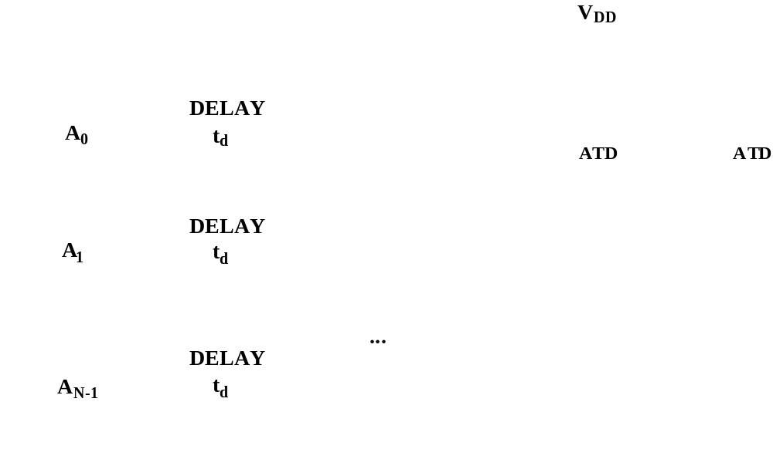
SRAM Address Transition Detection

Slide 18
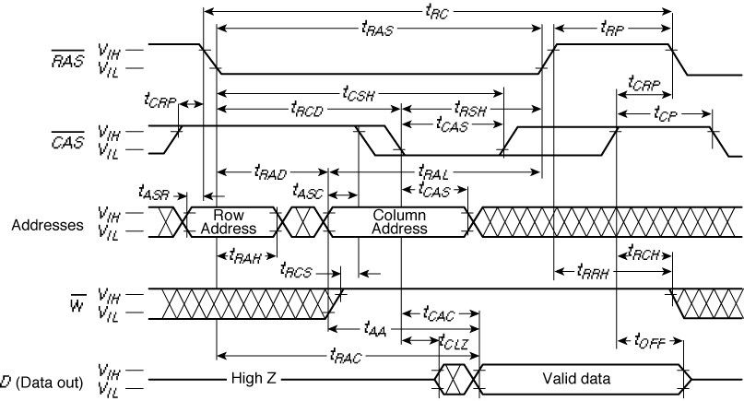
DRAM Timing

Slide 19
Review: A Typical Memory Hierarchy
By taking advantage of the principle of locality:
  Present the user with as much memory as is available in the cheapest technology.
  Provide access at the speed offered by the fastest technology.
On-Chip Components
Control
eDRAM
Instr
Cache
Second
Level
Cache
(SRAM)
Secondary
Memory
(Disk)
ITLB
Main
Memory
(DRAM)
Datapath
RegFile
DTLB
Data
Cache
Speed (ns): .1’s 1’s 10’s 100’s 1,000’s
Size (bytes): 100’s K’s 10K’s M’s T’s
Cost: highest lowest
Notes:
Instead, the memory system of a modern computer consists of a series of black boxes ranging from the fastest to the slowest.
Besides variation in speed, these boxes also varies in size (smallest to biggest) and cost.
What makes this kind of arrangement work is one of the most important principle in computer design. The principle of locality.
The design goal is to present the user with as much memory as is available in the cheapest technology (points to the disk).
While by taking advantage of the principle of locality, we like to provide the user an average access speed that is very close to the speed that is offered by the fastest technology.
(We will go over this slide in detail in the next lectures on caches).

Slide 20
Caches
Address issued by the data path has to be mapped (in hardware) into a cache address
Cache block (aka line) – unit of read/write information in cache
Cache mapping strategies
  Direct mapped
    A word can be in only one block in the cache, so only have to compare its tag against that block’s tag
  Block set associative
    A word can be in two (or four or eight …), so have to compare its tag against the tags of those two (or four or eight …) cache blocks
  Fully associative
    A word can be in any block in the cache, so have to compare its tag against the tags of all of the blocks in the cache
tag
which word in the cache block
which cache block in the set

Slide 21
Two-Way Block Set Associative Cache
Set 1
Set 2
Address issued by CPU
Tag
Data
Tag
Data
=
=
Hit
Desired word

Slide 22
Translation Lookaside Buffers (TLBs)
Small caches used to speed up address translation in processors with virtual memory
All addresses have to be translated before cache access
I$ can be virtually indexed/virtually tagged

Slide 23
TLB Structure
Address issued by CPU (page size = index bits + byte select bits)
VA Tag
PA
Tag
Data
Tag
Data
Hit
=
=
Most TLBs are small
(<= 256 entries)
and thus fully associative
content addressable memories (CAMs)
Hit
Desired word

Slide 24
CAM Design
WL<0>
Hit
word line<0>
of data array
WL<1>
match<0>
WL<2>
match<1>
WL<3>
match<2>
match<3>
Read/Write Circuitry
bit
bit
WL
match/write data
precharge/match
match
Notes:
Precharge all match lines high (so Hit = 0)
If the match data matches the data stored in the cell, it leaves the match line high so that Hit = 1; a mismatch pulls the match line low

Slide 25
Reliability and Yield
Semiconductor memories trade-off noise margin for density and performance
Thus, they are highly sensitive to noise (cross talk, supply noise)
High density and large die size causes yield problems
# of good chips/wafer
Yield = 100
# of chips/wafer
Y = [(1 – e^{–AD})/(AD)]²
Increase yield using error correction and redundancy
Notes:
Now a days have around 1 defect/cm**2
A is the chip area and D is the defect density – so the yield goes down as A*D goes up

Slide 26
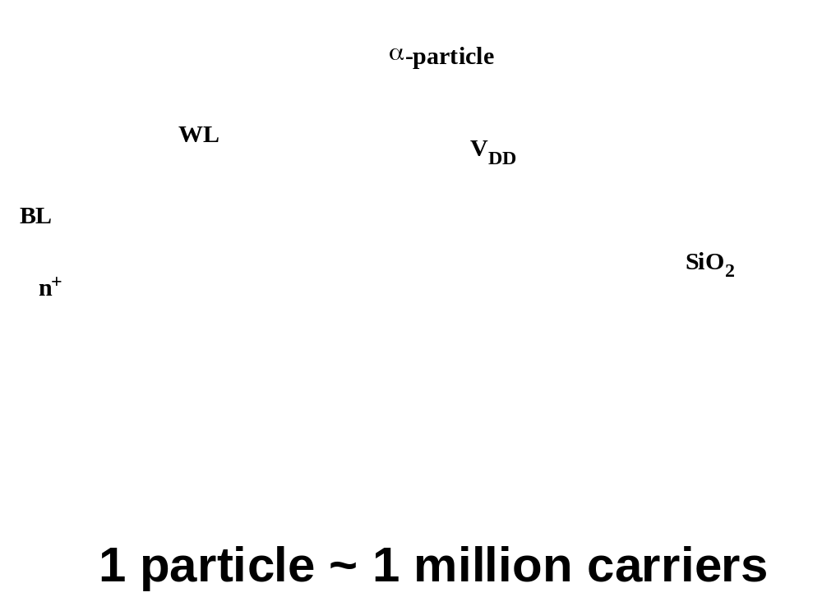
Alpha Particles

Slide 27
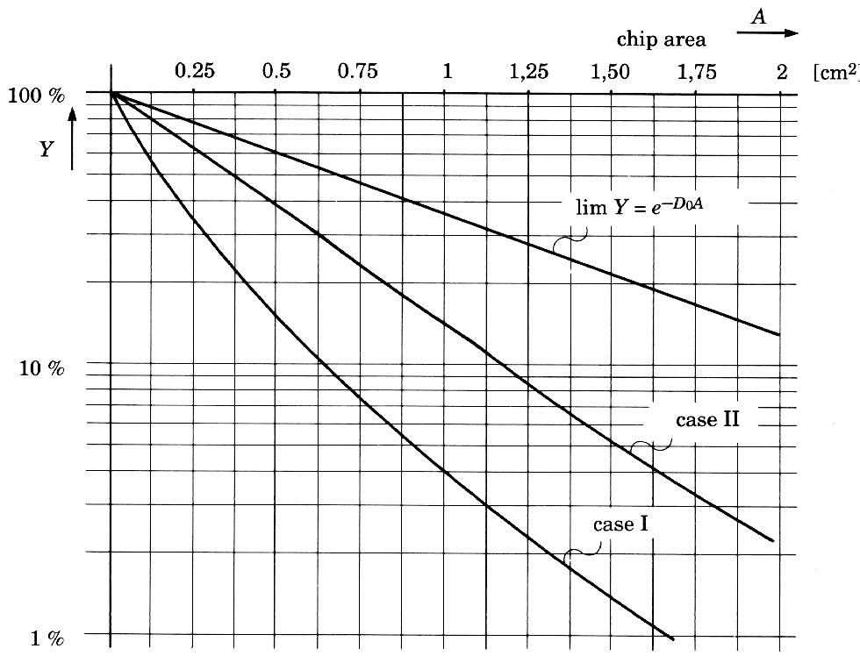
Yield
Yield curves at different stages of process maturity
(from [Veendrick92])

Slide 28
Redundancy in the Memory Structure
Fuse bank
Redundant row
Redundant columns
Row address
Column address
Notes:
Replace bad row or column with “spare” – done by setting the fuse bank
Helps to correct faults that affect a large section of the memory; not good for scattered point errors or local errors (use error correction (ECC) logic like parity bits for that)

Slide 29
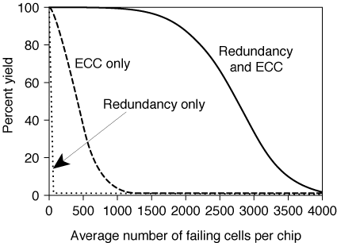
Redundancy and Error Correction

Slide 30
Next Lecture and Reminders
Next lecture
  System level interconnect
    Reading assignment – Rabaey, et al, xx
Reminders
  Project final reports due December 5th
  Final grading negotiations/correction (except for the final exam) must be concluded by December 10th
  Final exam scheduled
    Monday, December 16th from 10:10 to noon in 118 and 121 Thomas

